Slide 1


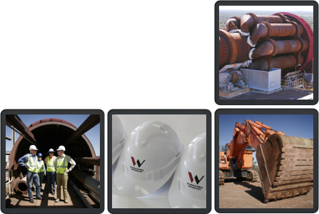
August 2008
Notes:
1

Slide 2
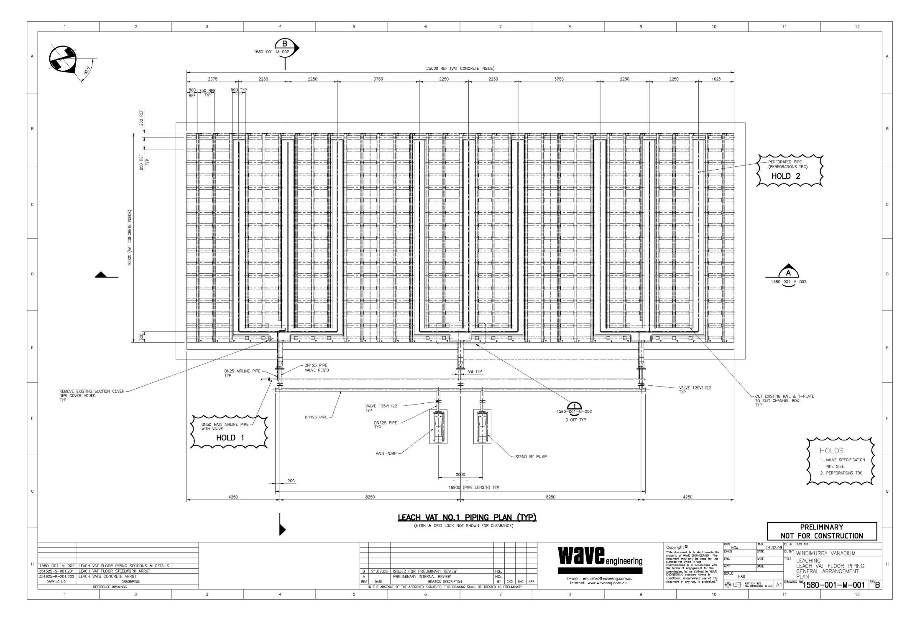
DRAWING 1

Slide 3
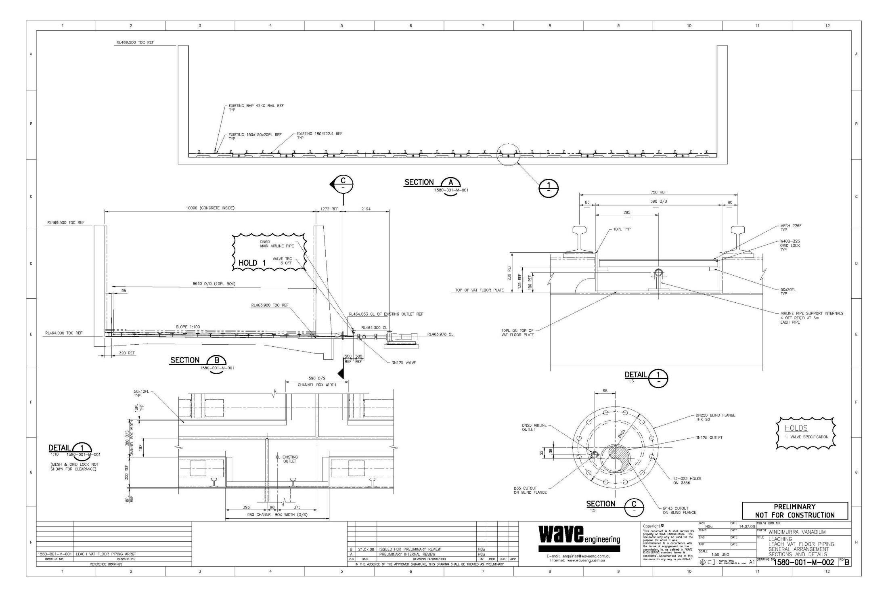
DRAWING 2

Slide 4
KEY POINTS
What are we trying to achieve?
  Purging the channels to keep them free of fines and
  Pressurising the channels to increase permeability through the bed.

Slide 5
KEY POINTS
Key Design Features:
  Utilise Slug Dose as purging solution so no additional solution in mass balance;
  Core drill into existing vat to run pipe for supplying solution;
  Use combination of valves and timed sequences to achieve outcomes;
  No additional pumps required;
  Channels will either be “V” or “U” shaped to facilitate flushing;
  Mesh plate to be “sandwiched” between 2 layers of grid mesh giving protection and adding strength;
  Grid mesh sections to be full length of vat with lifting lugs for easy “Lift in/Lift out” operation.

Slide 6
SEQUENCE OF EVENTS
Where to from now?
  Finalise layout by 15 August;
  Receive detailed drawings by 22 August to enable budget costing;
  Fabrication drawings for pipe spools to be let either through Proteus or direct to vendor and
  Fabricated pipe spools, etc to be given to SMP contractor for installation.
  COMMISSIONING!

